Slide 1


Predicting Churn Rate of an Audiobook App
Dr. AKHILESH DAS GUPTA INSTITUTE OF TECHNOLOGY & MANAGEMENT
(AFFILIATED TO GURU GOBIND SINGH INDRAPRASTHA UNIVERSITY, DELHI)
DEPARTMENT OF COMPUTER SCIENCE & ENGINEERING
Project by -
ARYAN GULATI ASHWIN KUMAR UNIYAL
CSE F1 CSE F1
01115602718 01315602718
DARSHPREET SINGH MAHAVIR SINGH
CSE F1 CSE F1
01915602718 02915602718
Under the guidance of
Dr. Anupam Kumar Sharma
Professor & HOD (Computer Science & Engineering)
25/04/2022

Slide 2
Department of Computer Science & Engineering
VISION
To produce socially responsible technocrats, researchers , and entrepreneurs in the field of computer science and engineering.
MISSION
M1 -To provide quality education in the field of computer science and engineering with emphasis on research and innovations.
M2 - To inculcate professional behaviour , strong ethical values, and leadership skills.
M3 - To provide a platform for promoting entrepreneurship and multidisciplinary activities.

Slide 3
Introduction
Identifying and analysing customers behaviour to get insights of the customer’s future action towards the subscription based app can be very helpful and decisive for the business.
The main idea is that if a customer has a low probability of coming back, there is no reason to spend any money on advertising to him/her. If we can focus our efforts SOLELY on customers that are likely to convert again, we can make great savings. Moreover, this model can identify the most important metrics for a customer to come back again, we can collect feedback early from customer which has a low probability of coming back to improve our services. Identifying new customers creates value and growth opportunities.
This predictive insight can help marketers of subscription ecommerce businesses in many ways by which they can easily increase their loyalty base , customers’ satisfaction and generate large revenue.

Slide 4
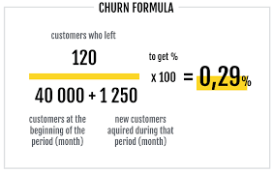
What Is An Attrition / Churn Rate?
Commonly referred to as a 'churn rate,' a company's attrition rate is the rate at which people leave. If you break it down, it is the number of people who have left the company, divided by the average number of employees over a period of time. Typically, it is expressed as a percentage (%).
Churn analysis helps shows how many people are sticking or leaving the product. This type of analysis looks across time periods to determine customer retention trends and losses incurred.

Slide 5
Project Goal
We have data from an Audiobook app. We want to create a machine learning model based on our available data that can predict if a customer will buy again from the Audiobook company.
>The data is from an audiobook app, each customer in the database has make a purchase at least once.
>The main idea is that the company shouldn't spend their money targeting individuals who are unlikely to come back.
>If we focus on client who are more likely to convert again we'll get increase the sales and profitability figures.

Slide 6
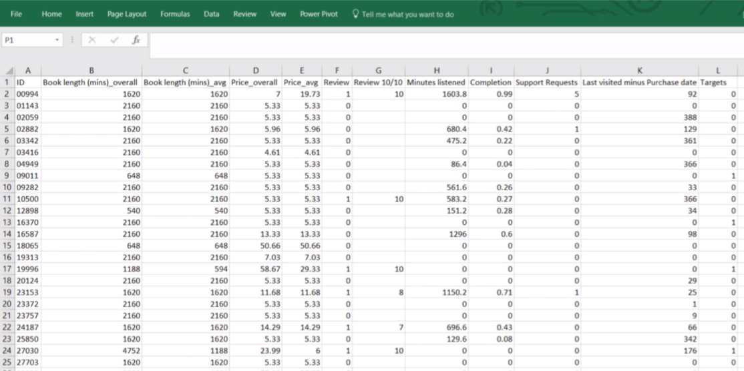
Dataset of Audiobook app
The data was gathered from the audiobook app.
The input data represents 2 years worth of engagement. We are doing supervised learning so we need target.
We took extra 6 month data to check if the user converted or not. 1 if the customer buys in the next 6 months, 0 if the customer didn't.
Many more ..

Slide 7
Getting acquainted with the dataset
ID: is like a name.
Book_length(mins)_overall: is the sum of the lengths of purchases.
Book_length(mins)_avg: is the sum of the lengths of purchases divided by the number of purchases. Notice we don't need the number of purchases column because we ca get it from Book_length(mins)_overall / Book_length(mins)_avg.
Price_overall & Price_avg: Same as Book length, the price variable is almost always a good predictor.
Review: is boolean. It shows if the customer left a review. If so, Review 10/10 saves the review left by the user. While most users don't left a review we fill the missing reviews by average review column.

Slide 8
Minutes_listened: is a measure of engagement, the total of minutes the user listen to audiobooks.
Completion: is the Minutes_listened / Book_length(mins)_overall.
Support_Request: Shows the total number of support request (forgotten password to assistance).
Last_Visited_mins_Purchase_date: the bigger the difference, the bigger sooner the engagement. If the value is 0, we are sure the customer has never accessed what he/she has bought.
Targets: Shows whether the customer has made a purchase within next 6 months or not.
0 being no and 1 being yes.

Slide 9
Machine learning algorithms to be used
Logistic Regression : is a process of modeling the probability of a discrete outcome given an input variable. The most common logistic regression models a binary outcome; something that can take two values such as true/false, yes/no, and understand the relationship between the dependent variable and one or more independent variables by estimating probabilities using a logistic regression equation. This type of analysis can help you predict the likelihood of an event happening or a choice being made.
Random Forest : or random decision forests is an ensemble learning method for classification, regression and other tasks that operates by constructing a multitude of decision trees at training time. For classification tasks, the output of the random forest is the class selected by most trees.
Extreme Gradient Boosting (XGBOOST) : XGBoost (Extreme Gradient Boosting) belongs to a family of boosting algorithms and uses the gradient boosting (GBM) framework at its core.
Deep Learning

Slide 10
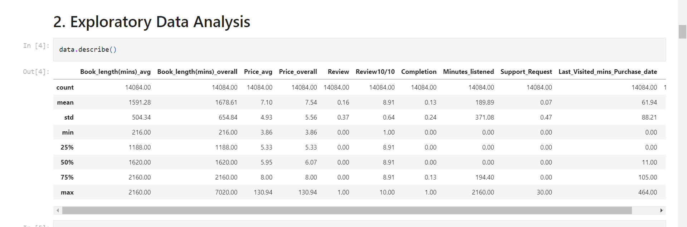
Second Progress Report
Tasks Completed
Data Analysis
Data Cleaning
Data Preprocessing
Model Building

Slide 11
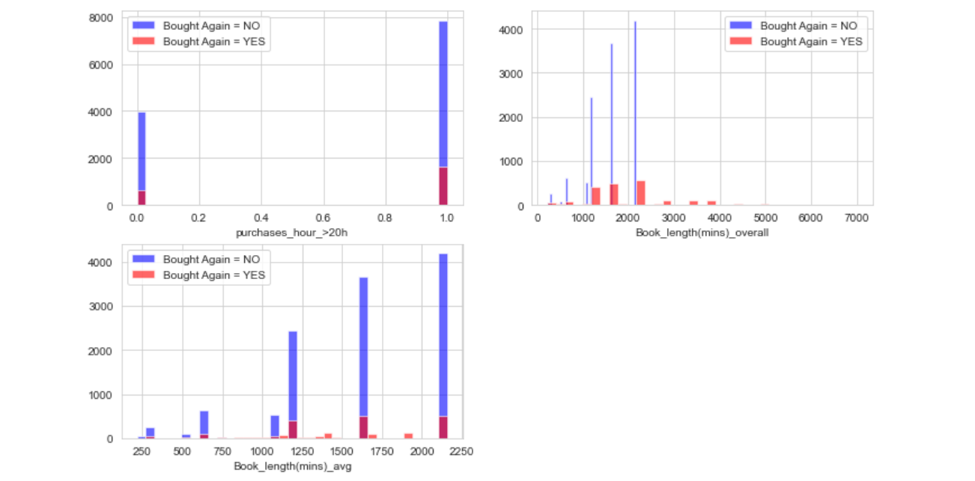
Purchase hour > 20, total book length, avg book length

Slide 12
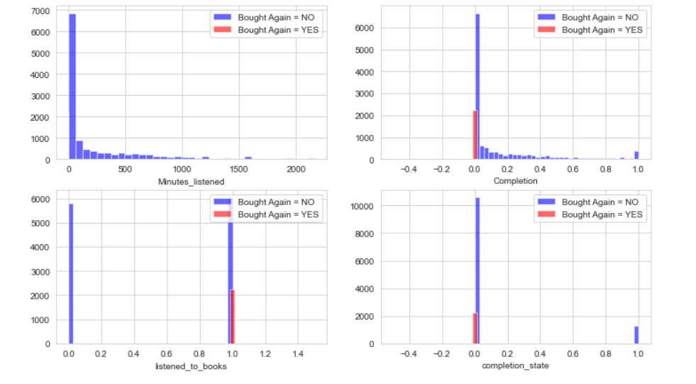
Minutes_listened & Completion

Slide 13
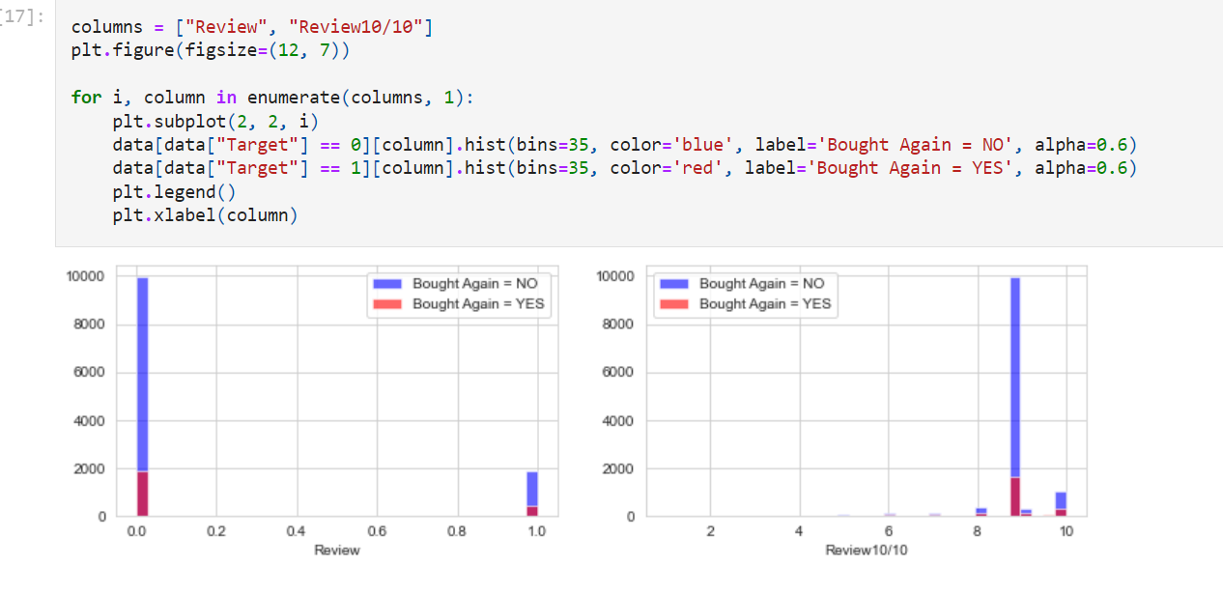
Review & Review10/10

Slide 14
Data Pre-processing
Since we are dealing with real life data, we will need to preprocess it a bit. The following tasks have been completed
Balance the dataset.
Very few users have purchased subscriptions, so for creating the model we have to balance the dataset between users who have purchased the subscription & who have not, we have to make their number equal so that machine does not get bias
Standardising
Data have large values for minutes column while price feature has small values, so we need to scale the data to a normal distribution having mean 0 & variance 1
Shuffling
Shuffle the dataset randomly
Splitting
Splitting the data in training, testing & validation

Slide 15
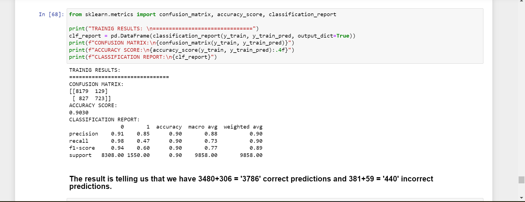
Logistics Regression Training Results

Slide 16
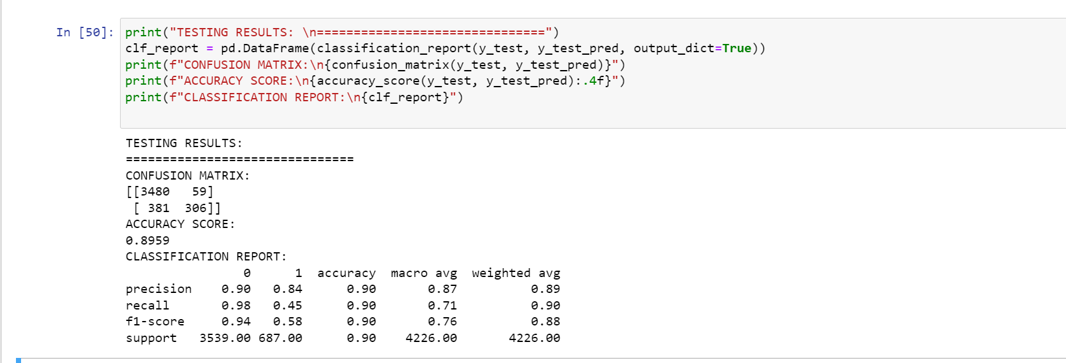
Logistics Regression Testing Results

Slide 17
Outcome/Result
We want to create a machine learning model based on our available data that can predict if a customer will buy again from the Audiobook company.
If a customer has a low probability of coming back, there is no reason to spend any money on advertising to him/her. If we can focus our efforts SOLELY on customers that are likely to convert again, we can make great savings.
Moreover, this model can identify the most important metrics for a customer to come back again. Identifying new customers creates value and growth opportunities.

Slide 18






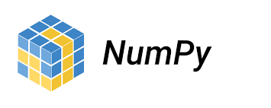
Technology/Tech Stack Required
Python Environment
Numpy, Pandas, Visualization Libraries
Machine Learning Algorithms
Tensorflow , Keras
MS Excel
Jupyter Notebook

Slide 19
References
Kaggle.com : For dataset and understanding different models based on same dataset.
365Careers.com : Theoretical and Practical understanding for different ML algorithms.
Towardsdatascience.com : For deeper knowledge of working with data, preprocessing, fitting the model etc
https://downloads.hindawi.com/journals/ddns/2021/7160527.pdf
https://www.researchgate.net/publication/329379548_Analysis_of_Churn_Rate_Significantly_Factors_in_Telecommunication_Industry_Using_Support_Vector_Machines_Method
https://www.researchgate.net/publication/295257947_Churn_analysis_Predicting_churners
https://www.statista.com/statistics/384224/monthly-app-launches-churn/

Slide 20
Future Scope
Integrating with mobile app for Increasing User Experience
Including more Apps / Data
Increasing accuracy of Model
Creating Visualization Dashboard
Integrating with Recommender System/ Model

Slide 21
TASK(s) Completed with TimeLine
February (25-28)
Data Collection
March (1 - 20)
Data Cleaning
March (20 ) - April (26)
Solving Problem with Machine learning Model (Brute Force Approach)
Optimization

Slide 22
Thank You

